Slide 1

Face Mask Detection
RNS INSTITUTE OF TECHNOLOGY
BENGALURU - 98
DEPARTMENT OF INFORMATION SCIENCE & ENGINEERING
Presentation on Internship
Kirtana Sridharan
USN: 1RN18IS061
New Age Solutions Technologies
Internal Guide
Dr. R Rajkumar
Asso. Prof., Dept of ISE, RNSIT
External Guide
Mr. Deepak Garg
CEO, NASTECH

Slide 2
AGENDA
Abstract
About the Company
Introduction
Literature Survey
Requirements
System Design
Detailed Design
Implementation
Results
Conclusion and Future Enhancements
References
Q & A

Slide 3
ABSTRACT
The corona virus COVID-19 pandemic is causing a global health crisis so the effective protection methods is wearing a face mask in public areas according to the World Health Organization (WHO).
Reports indicate that wearing face masks while at work clearly reduces the risk of transmission.
A face mask detection software reduces many efforts in the tasks which can be automated.
Face Mask detection has turned up to be an astonishing problem in the domain of image processing and computer vision.
Face detection has various use cases ranging from face recognition to capturing facial motions, where the latter calls for the face to be revealed with very high precision.

Slide 4
ABOUT THE COMPANY
NASTECH – New Age Solutions & Technologies
NASTECH is formed with the purpose of bridging the gap between Academia and Industry.
Nastech is one of the leading Global Certification and Training service providers for technical and management programs for educational institutions.
They collaborate with educational institutes to understand their requirements and form a strategy in consultation with all stakeholders to fulfill those by skilling , reskilling and upskilling the students and faculties on new age skills and technologies.
Industry and project oriented student training programs.
Certification programs mapped to Global Certification Exams from Microsoft/EC- Council/Google/AWS/ Adobe).

Slide 5
INTRODUCTION
Face detection has various use cases ranging from face recognition to capturing facial motions, where the latter calls for the face to be revealed with very high precision.
The proposed system focuses on how to identify the person on image/video stream wearing face mask with the help of computer vision and deep learning algorithm by using the OpenCV, Tensor flow and Keras library
The detection is carried out to see if particular person is wearing a mask or not with the help of Convolution Neural Networks(CNN) algorithm that the Sequential model uses.

Slide 6
LITERATURE SURVEY
[1]In 2016, study of masked face detection approach in video analytics was proposed by Gayatri Deora and Ramakrishna. When face detection can be triggered by calculating the distance between a person and camera. Viola Jones Algorithm is used for facial detection, such as detection of eyes, nose and mouth etc.
This algorithm provides very high detection rates and low false positive rate. As a result poor image quality leads to high false detection rate.
[2] In 2020, “Real time data analysis of face mask detection and social distance measurement using Matlab” proposed by S. Meivel, K. Indira Devi, S. Uma Maheswari , J. Vijaya Menaka. In this paper they have introduced mask detection technique done using Matlab.
Complex pictures with large crowds and low light are dealt in this model of mask detection using Matlab. The Faster R-CNN algorithm is generally used in complex security and medical systems. Lot of complexities like colour changes, contrast changes, brightness changes, balanced face restricting are dealt in this model using Matlab.
The researchers who are involved in this work have mainly concentrated on the complexities in these face detection models generally and taken it as a challenge to improve the models efficiency instead of these challenges, hence this a good and unique attempt to take up the difficulties and sort out the challenges for future use and development of these mask detection models and they have chosen Matlab as the new inclusion in order to achieve this feat.

Slide 7
LITERATURE SURVEY
[3] In 2020, Retinal Face Mask Detector proposed by Mingjie Jiang, Xinqi fan and Hong.
It is a One-stage object detector. The dataset contained 7959 images.
The ResNet and mobileNet used as BACKBONE. But ResNet is considered as standard backbone. The detection network includes a backbone, a neck and head modules. As a result the ResNet accuracy is very much higher than the Mobile Net.

Slide 8
REQUIREMENTS
HARDWARE REQUIREMENTS
Processor : Any Processor above 500 MHz
RAM : 512Mb
Hard Disk : 4 GB
Input device : Standard Keyboard and Mouse
Output device : VGA and High Resolution Monitor
SOFTWARE REQUIREMENTS
Operating system : Windows 10
IDE : Jupyter Notebook
Tools/Technologies : Python, Computer Vision, OpenCv, Keras API, Numpy library

Slide 9
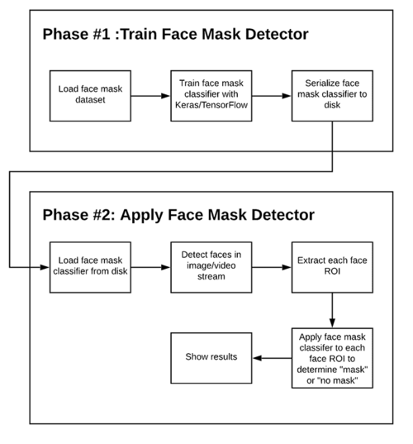
SYSTEM DESIGN
As depicted in the figure, the project is divided in two phases.
Phase 1 deals with loading, preprocessing and training the data set. In this phase, the model that performs training on the data set the best, in other words, the model that provides highest accuracy, is saved onto the disk.
Phase 2 deals with loading the model that was saved in the previous phase, to test it by feeding a real time video.
The OpenCV library is used to detect faces in the video stream that is fed continuously to the model.
From each face that is detected, the region of interest (ROI) is extracted and the classifier is applied to the extracted image to detect whether the person in the image is wearing mask or not.

Slide 10
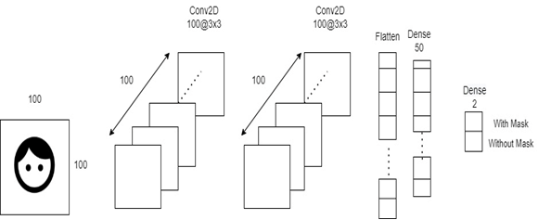
SYSTEM DESIGN
This convolution network consists of two pairs of Conv and MaxPool layers that serve as the input and the hidden layer of the network to extract features from the dataset.
The hidden layer is then followed by a Flatten and Dropout layer to convert the data in 1D and ensure overfitting.

Slide 11
DETAILED DESIGN
FUNCTIONAL MODULES
The entire project is divided into 3 modules:
Face Detection
Face Tracking
Face Mask Detection
Face Detection:
This module takes input from the camera and tries to detect a face in the video input. The detection of the face is achieved through the Haar classifiers mainly, the Frontal face cascade classifier.
The face is detected in a rectangle format. Face detection is accomplished by the OpenCV algorithm proposed by Paul Viola and Michael Jones in 2001.
2. Face tracking
Due to the real-time nature of the project, the faces need to be tracked continuously for any form of distraction. Hence the faces are continuously detected during the entire time.
If faces are found, it returns the positions of detected faces as rect(x,y,w,h). Once these locations are returned, we can draw a rectangular box around the location that would depict the region of interest( ROI) for the face .

Slide 12
IMPLEMENTATION
TRAINING CODE
model = Sequential([
Conv2D(100, (3,3), activation='relu', input_shape=(150, 150, 3)),
MaxPooling2D(2,2),
Conv2D(100, (3,3), activation='relu'),
MaxPooling2D(2,2),
Flatten(),
Dropout(0.5),
Dense(50, activation='relu'),
Dense(2, activation='softmax')
])
model.compile(optimizer='adam', loss='binary_crossentropy', metrics=['acc'])
model.summary()
TRAINING_DIR = "./train"
train_datagen = ImageDataGenerator(rescale=1.0/255,
rotation_range=40,
width_shift_range=0.2,
height_shift_range=0.2,
shear_range=0.2,
zoom_range=0.2,
horizontal_flip=True,
fill_mode='nearest')
train_generator = train_datagen.flow_from_directory(TRAINING_DIR,
batch_size=10,
target_size=(150, 150))
VALIDATION_DIR = "./test"
validation_datagen = ImageDataGenerator(rescale=1.0/255)
validation_generator = validation_datagen.flow_from_directory(VALIDATION_DIR,
batch_size=10,
target_size=(150, 150))
checkpoint = ModelCheckpoint('model2-{epoch:03d}.model',monitor='val_loss',verbose=0,save_best_only=True,mode='auto')
history = model.fit_generator(train_generator,
epochs=10,
validation_data=validation_generator,
callbacks=[checkpoint])

Slide 13
IMPLEMENTATION
TESTING AND LIVE DETECTION
haarcascade = cv2.CascadeClassifier(cv2.data.haarcascades + 'haarcascade_frontalface_default.xml')
while True:
(rval, im) = cap.read()
im=cv2.flip(im,1,1)
rerect_size = cv2.resize(im, (im.shape[1] // rect_size, im.shape[0] // rect_size))
faces = haarcascade.detectMultiScale(rerect_size)
for f in faces:
(x, y, w, h) = [v * rect_size for v in f]
face_img = im[y:y+h, x:x+w]
rerect_sized=cv2.resize(face_img,(150,150))
normalized=rerect_sized/255.0
reshaped=np.reshape(normalized,(1,150,150,3))
reshaped = np.vstack([reshaped])
result=model.predict(reshaped)
label=np.argmax(result,axis=1)[0]
cv2.rectangle(im,(x,y),(x+w,y+h),GR_dict[label],2)
cv2.rectangle(im,(x,y-40),(x+w,y),GR_dict[label],-1)
cv2.putText(im, results[label], (x, y-10),cv2.FONT_HERSHEY_SIMPLEX,0.8,(255,255,255),2)
cv2.imshow('LIVE', im)
key = cv2.waitKey(10)
if key == 27:
break
cap.release()
cv2.destroyAllWindows()

Slide 14
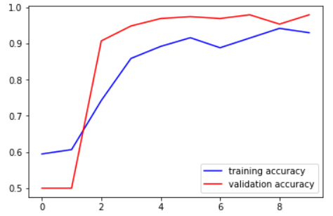
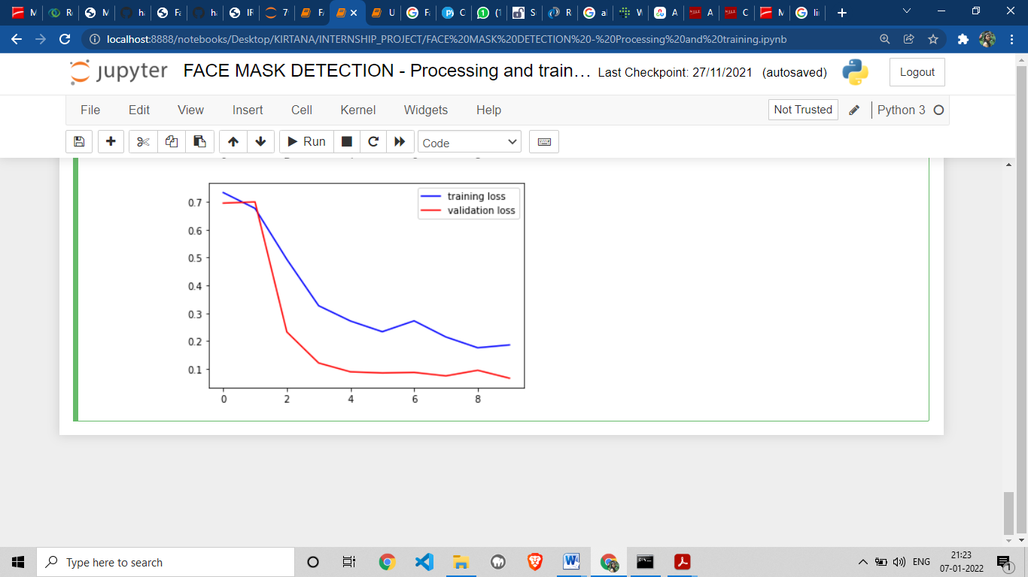
RESULTS
It can also be observed in the accuracy loss graph obtained below:
The accuracy of the model is 92%.
The loss value is below 0.1.
It can be observed that with every iteration of the model training, the loss is getting gradually decreased and the accuracy is getting increased.

Slide 15
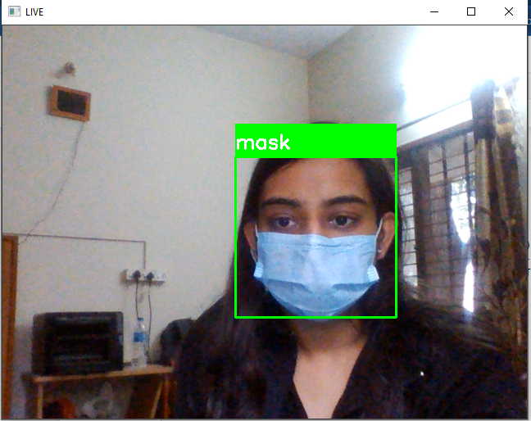
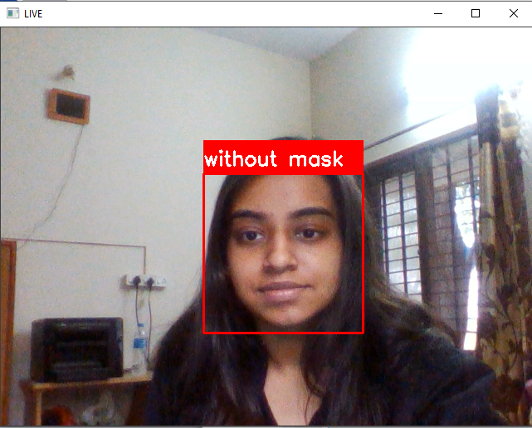
RESULTS

Slide 16
CONCLUSIONS
As is evident nowadays that face mask detection is very crucial, given the current scenario of the Covid-19 pandemic, this project was an attempt in creating a simple face mask detetctor..
In this project, a deep learning model for face mask detection was developed with the help of Convolutional Neural Networks using Python, Keras, and OpenCV.
The observed model proved to be 92% accurate in the detection of the presence of masks on the person’s face.
Face Mask Detection has found its application in various places such in airports, hospitals, offices and other likely public places.

Slide 17
LIMITATIONS
The system has difficulty detecting certain faces when wearing a mask.
This problem is due to the fact that initially, the Open CV Deep Learning based face detector was being used and it is not designed to detect faces with masks.
It could also be observed that the face recognition stage is not robust when the detected face presents a certain angle of inclination.
However, this is not a problem of great impact, as this application is oriented to access control and at this point, the person must maintain a firm and straight posture in front of the device that acquires the image.

Slide 18
FUTURE ENHANCEMENTS
To circumvent aforementioned issue, we can train a two-class object detector that consists of a with_mask class and without_mask class. Combining an object detector with a dedicated with_mask class will allow improvement of the model in two respects.
First, the object detector will be able to naturally detect people wearing masks that otherwise would have been impossible for the face detector to detect due to too much of the face being obscured.
Secondly, this approach reduces our computer vision pipeline to a single step — rather than applying face detection and then our face mask detector model, all we need to do is apply the object detector to give us bounding boxes for people both with_mask and without_mask in a single forward pass of the network.
Not only is such a method more computationally efficient, it’s also more “elegant” and end-to-end.

Slide 19
REFERENCES
[1] Gayatri Deora, Ramakrishna Godhula and Dr. Vishwas Udpikar “Study of Masked Face Detection Approach in Video Analytics”. 2016, IEEE Conference on Advances in Signal Processing.
[2] S. Meivel, K. Indira Devi, S. Uma Maheswari , J. Vijaya Menaka “Real time data analysis of face mask detection and social distance measurement using Matlab”, Dec 2020.
[3] Mingjie Jiang, Xinqi Fan and Hang Yan “Retinal Face Mask Detector”. 9 June 2020, Hong Kong University.
[4] https://docs.opencv.org/3.4/db/d28/tutorial_cascade_classifier.html
[5] https://medium.com/analytics-vidhya/haar-cascades-explained-38210e57970d

Slide 20
Question and Answer

Slide 21
THANK YOU

